Slide 1
3. Practical screen
Theory development with systematic literature reviews
Chitu Okoli for ICT University, Fall 2015

Slide 2
What is a practical screen?
The practical screen is the set of decisions about which kinds of studies to look for and which ones to not even look for.
Reduces the number of studies to be analyzed to a number that can be practically handled by the reviewers
Not a quality appraisal, but pragmatic restriction of the scope of the study

Slide 3
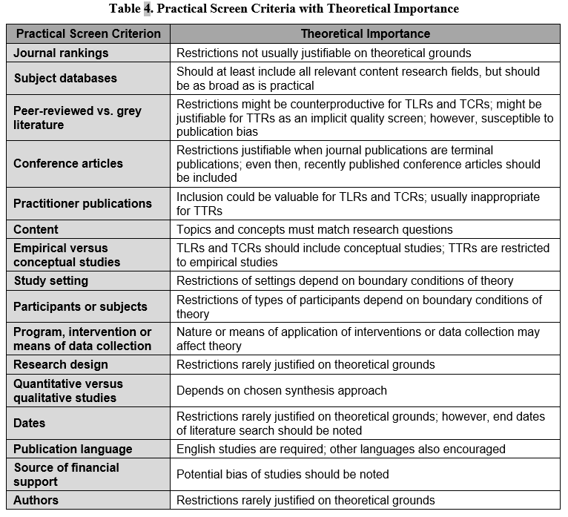
Practical screen criteria with theoretical importance
(Okoli 2015)

Slide 4
Types of articles to include
Journal rankings
Restrictions not usually justifiable on theoretical grounds
Peer-reviewed vs. grey literature
Restrictions might be counterproductive for TLRs and TCRs; might be justifiable for TTRs as an implicit quality screen; however, susceptible to publication bias
Conference articles
Restrictions justifiable when journal publications are terminal publications; even then, recently published conference articles should be included
Practitioner publications
Inclusion could be valuable for TLRs and TCRs; usually inappropriate for TTRs

Slide 5
Topic of study
Subject databases
Should at least include all relevant content research fields, but should be as broad as is practical
Content
Topics and concepts must match research questions

Slide 6
Nature of empirical studies
Empirical versus conceptual studies
TLRs and TCRs should include conceptual studies; TTRs are restricted to empirical studies
Study setting
Restrictions of settings depend on boundary conditions of theory
For example, why might the theory only apply in developing countries?
Participants or subjects
Restrictions of types of participants depend on boundary conditions of theory
Program, intervention or means of data collection
Nature or means of application of interventions or data collection may affect theory
Research design
Restrictions rarely justified on theoretical grounds
Quantitative versus qualitative studies
Depends on chosen synthesis approach
Source of financial support
Potential bias of studies should be noted

Slide 7
Bibliographic characteristics of the articles
Dates
Restrictions rarely justified on theoretical grounds; however, end dates of literature search should be noted
Publication language
English studies are required; other languages also encouraged
Authors
Restrictions rarely justified on theoretical grounds

Slide 8
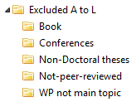
Practical tips for the practical screen
After the search, read titles and abstracts to determine if the inclusion criteria are met
If necessary, refer to the full text
In reference management software, create folders for excluded articles, with reasons for exclusion
Different reviewers should maintain their own exclusion folders
Enables comparison, verification, and tests of interrater reliability

Slide 9
Sources
Okoli, Chitu. The view from giants’ shoulders: guidelines for developing theory with theory-mining literature reviews. Working paper, 2015.

