Slide 1
2. Protocol and training
Theory development with systematic literature reviews
Chitu Okoli for ICT University, Fall 2015

Slide 2
What is a protocol for a literature review?
“A plan that describes the conduct of a proposed systematic literature review (Kitchenham & Charters, 2007, p. vi)
Protocol should be considered a working draft:
Initial protocol after objectives specified
Could be published in conference as research in progress
Revised protocol after training research team
Iteratively revised protocol during execution of review
Final result is a first draft of the final article

Slide 3
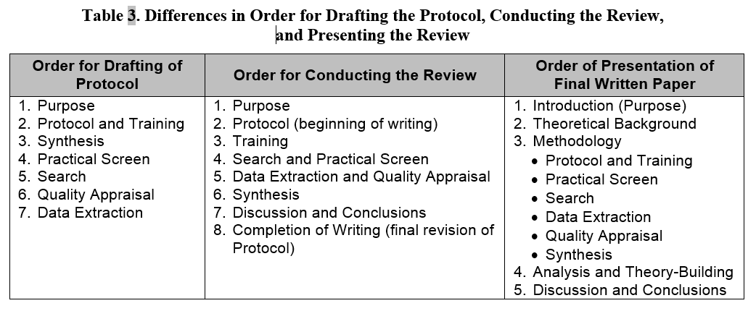
Order for drafting the protocol

Slide 4
Research questions for theory-mining reviews (TMRs)
Theory-landscaping review (TLR)
Focuses on a theme, a topic or a single concept as its scope, but not on theoretical relationships.
What theory (concepts and relationships) do we know about this topic?
Theory-contending review (TCR)
Focuses explicitly on theoretical relationships (at least two concepts) as the scope of the review, but without empirical verification
What theory (concepts and relationships) do we know about these specific relationships?
How can we improve the existing theory with new relationships or better explanations?
Theory-testing review (TTR)
Tests theoretical relationships (at least two concepts) using empirical secondary data
What empirical evidence exists to support or contradict this theory (concepts and relationships)?
How can we explain disparities in empirical studies?

Slide 5
Training the review team
Ideally, standalone lit review should be conducted as team research
Realistically, resource constraints are not ideal
Even less so for a doctoral dissertation
Key aspects of training
Protocol is training manual, with various worksheets (e.g. for data extraction)
Research ethics and plagiarism
Reference management software (e.g., Zotero)
Standards for taking notes

Slide 6
Research ethics and plagiarism
For all co-authored work, it is critical that all team members are properly trained in research ethics, especially concerning plagiarism
One improperly trained team member could get everyone else in trouble!
Useful training resources:
Association for Information Systems (AIS) Code of Research Conduct
Wendy Belcher's notes on plagiarism, especially “paraphrase plagiarism” (Belcher, 2009, pp. 161-163)
Plagiarism Tutorial from Simon Fraser University
Trainees should read every page in the tutorial, and do all the online quizzes
Repeat the quizzes until they achieve a perfect score in each one.
Especially for new researchers (e.g. students), team members should have a meeting dedicated to make sure that everyone fully understands these matters

Slide 7
“Review team” for individual doctoral dissertation
Doctoral candidate
Does 95% of the work
Test-retest reviewing can assess intra-reviewer reliability (Fink 2005, pp. 176-177)
Supervisor
Supervises, and could serve as “gold standard” (Fink 2005, pp. 176-177)
Other committee members
Peer review the protocol first (during Step 2) and final drafts (after Step 7)
Fellow doctoral students
Second coders for samples (minimum 10% of items, ideally minimum 50)
Train on 2-5 studies, then pilot on 10-20 studies
Train again and then full 10%
Interrater reliability statistics
Be sure to learn from differences

Slide 8
Examples of protocols
Appendix 3 from Kitchenham and Charters (2007)
Wikipedia systematic literature review (Okoli & Schabram 2009)
Okoli open music (Okoli & Zhang 2013)
Section (pages 202-203) from Elliot (2011)

Slide 9
Pilot study (for full literature review)
As much as possible, a first-run of the entire review
Two approaches:
At least first run of the search and practical screen
Gives a realistic idea of how many studies and what kind of studies might exist
Practice run of each step (particularly the search, data extraction and synthesis) before fully executing the respective step for the final study
Each pilot test reveals new lessons and should help to revise the protocol
Catch errors early and make corrections to the protocol in time to improve the final study

Slide 10
Pilot study for this literature review doctoral course
Comprehensive literature search and summative synthesis
Comprehensive literature search:
Search to find all relevant literature, with full search and practical screen
Select only a manageable number (10-20) of promising studies
Summative synthesis
Identify concepts and relationships only in selected studies
Map relationships with causal modeling
Pilot study for this course will have all steps completed
After this course, synthesize all remaining studies and revise theory accordingly

Slide 11
Sources
Belcher, Wendy Laura, 2009. Writing your journal article in 12 weeks: A guide to academic publishing success, Sage Publications: Thousand Oaks, USA.
Elliot, S. 2011. “Transdisciplinary Perspectives on Environmental Sustainability: A Resource Base and Framework for IT-Enabled Business Transformation,” MIS Quarterly (35:1), pp. 197–236.
Fink, A. (2005). Conducting research literature reviews: From the Internet to paper (2nd ed.). Thousand Oaks, CA: Sage.
Kitchenham, B., & Charters, S. (2007). Guidelines for performing systematic literature reviews in software engineering (Technical Report No. EBSE-2007-01). Keele, UK: Keele University.
Okoli, Chitu and Schabram, Kira, Protocol for a Systematic Literature Review of Research on the Wikipedia (October 27, 2009). Available at SSRN: http://ssrn.com/abstract=2291710
Okoli, C., & Zhang, W. (2014). From Pests to Pets: Effects of Open Content Licensing on the Distribution of Music. In Proceedings of the 22nd European Conference on Information Systems. Tel Aviv: Association for Information Systems.

