Slide 1
COMM 226 Modeling business processes with Business Process Model and Notation (BPMN)
Chitu Okoli
Associate Professor in Business Technology Management
John Molson School of Business, Concordia University, Montréal

Slide 2
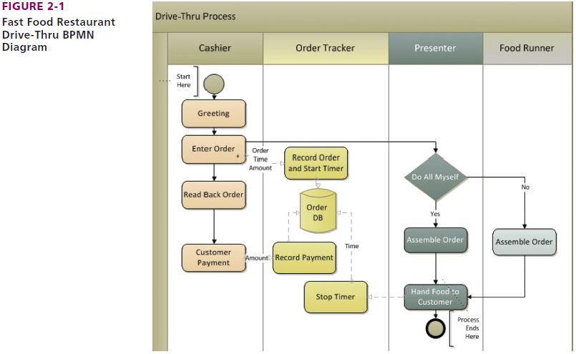
BPMN: standard modeling (diagraming) method
Notes:
In this slide, let’s focus on the design. You see various roles identified using vertical swimlanes. As an example, the first role is the Cashier. The activities performed by this role are shown using various symbols that we will discuss in the next slide. Keep in mind, the role of Cashier is performed by an actor that we define as a person.

Slide 3
Introduction to BPMN
http://youtu.be/sscOXEHVE6A
Notes:
Another approach to process improvement is Six-Sigma. This is a widely used approach, particularly in the manufacturing industry. The goal of Six-Sigma is to remove causes of defects and minimize variability in the process. As a result, 99.99966 percent of process outputs will be free from defects.

Slide 4
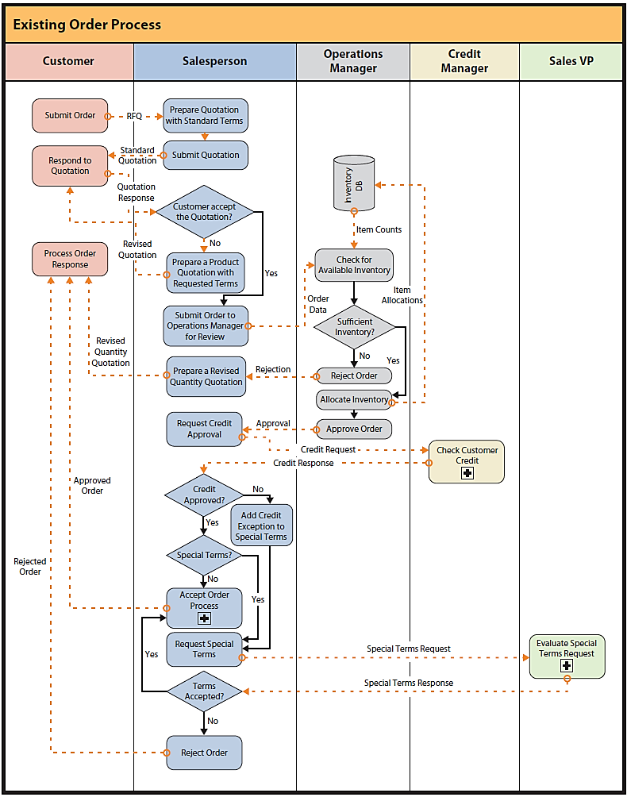
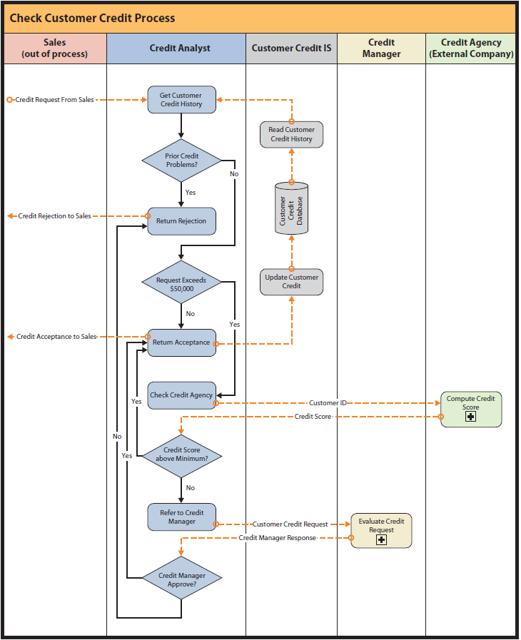
As-Is Business Order Process: Existing Ordering Process
Ought-to-be Business Order Process: Improved Ordering Process
Notes:
All activities for a given role are shown in that role’s swim lane. Swim-lane layout simplifies process diagrams and draws attention to interactions among components of the diagram.
Dotted arrows depict the flow of messages and data flows. Solid arrows depict the flow or sequence of the activities in the process.
Three of the activities in the “as-is” diagram contain a square with a plus (+) sign. This notation means that the activity is considered to be independent of this process and is defined in greater detail in another diagram.

Slide 5
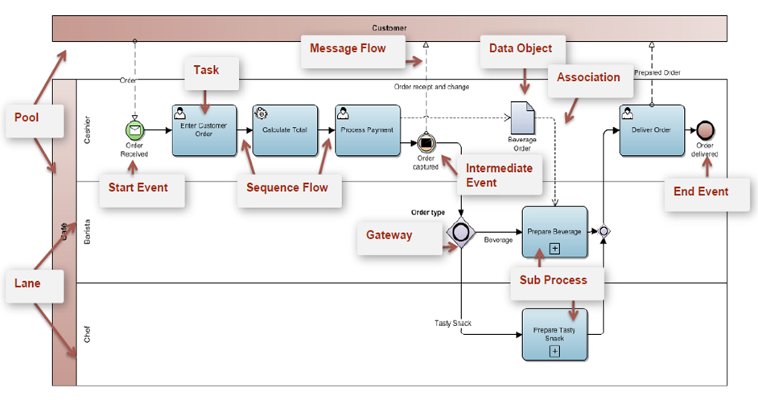
Core BPMN elements
For a very thorough tutorial, see http://camunda.org/bpmn/reference/.

Slide 6
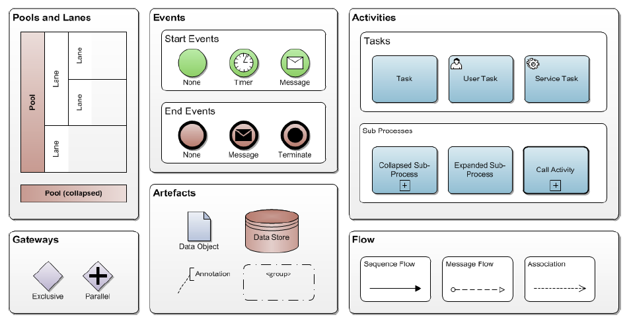
Some common BPMN symbols

Slide 7
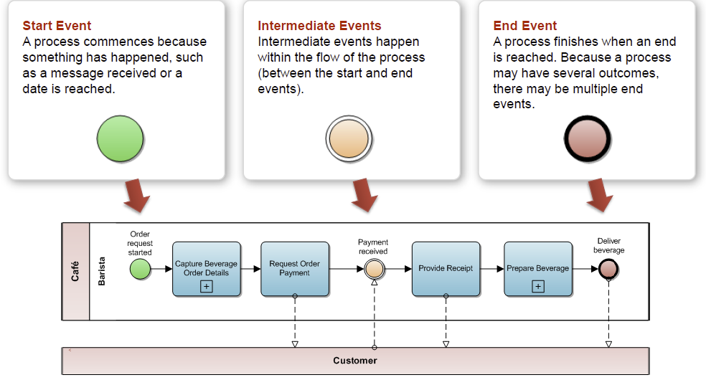
BPMN events
An event is an indicator that something has happened within a process.

Slide 8
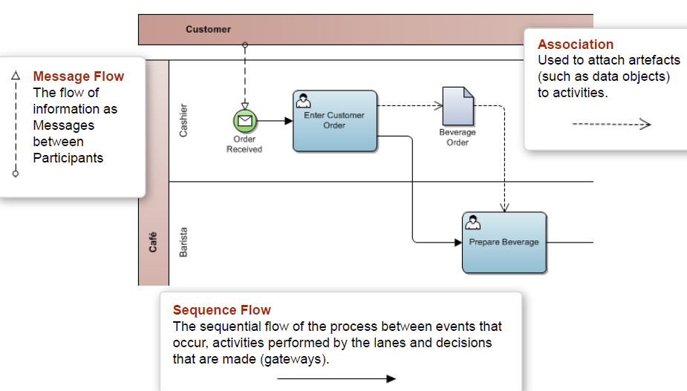
BPMN flows
Sequence Flow, Message Flow and Associations

Slide 9
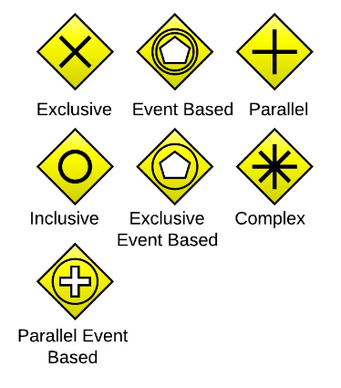
BPMN gateways
Gateways are decision points where the sequence of activities splits up or recombines
Many types exist, but the most common ones are:
×(Exclusive): only one choice can be selected
This is the default, if no shape is shown
O (Inclusive): one or more or even all choices might be chosen
+ (Parallel): all choices are carried out in parallel (at the same time)
Default: Exclusive
Shapes adapted from Wikipedia

Slide 10
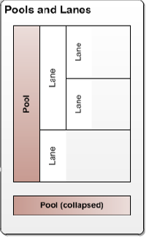
Modeling with multiple pools
A pool represents an independent organization
A lane within a pool is an individual actor or role (either a person or an information system) within an organization

Slide 11
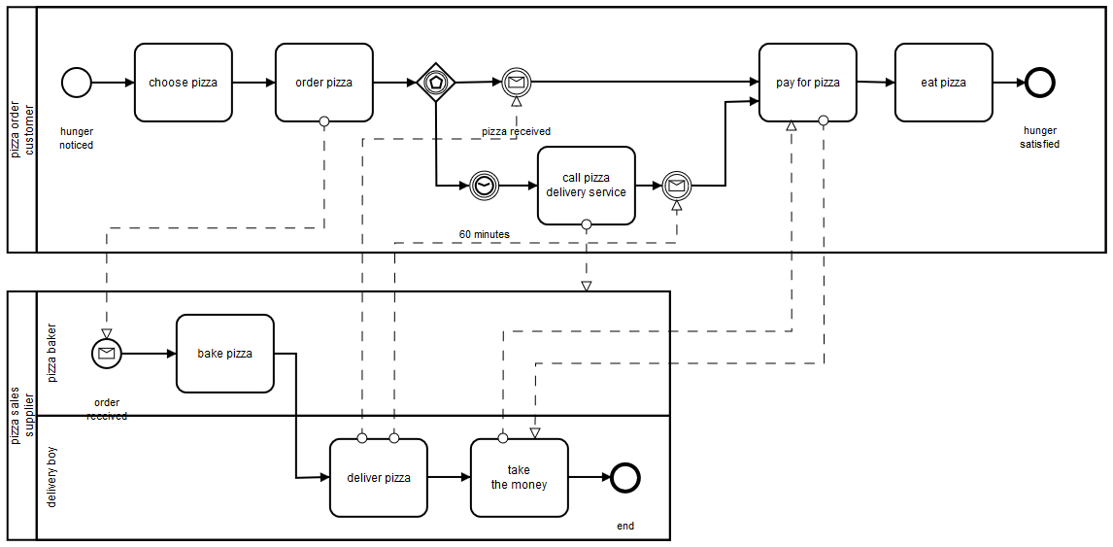
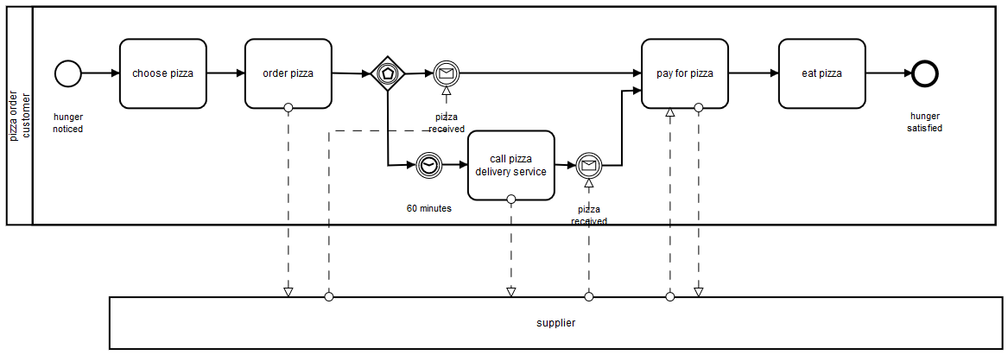
Modeling with multiple pools
Each pool gets its own complete process
Every white-box (non-collapsed) pool must have its own start and end events
Sequence flows only occur within pools, never from one pool to another
Only message flows can be used from one pool to another
Source: Camunda

Slide 12
Drawing BPMN diagrams
Microsoft Visio (Windows only)
60-day free trial
Available in SCBTM lab (MB 12.314)
Video tutorial for COMM 226
Free online diagramming tools (any operating system)
Lucidchart
Gliffy

Slide 13
An example of BPMN in Visio

Slide 14
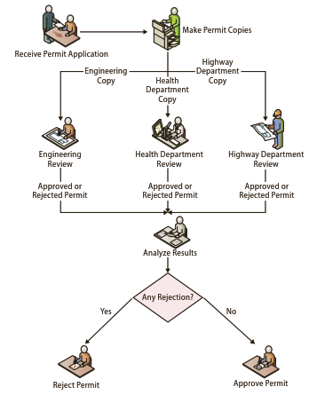
Collaboration Exercise 5: Building project permit process
Figure 5-21: As-is
Figure 5-22: Ought-to-be

Slide 15
BPMN exercise
Based on Collaboration Exercise 5 in PSI pp. 149-151, in groups of 3-4 students, draw the BPMN for Figure 5‑22 only: The permit office made three copies of the permit and distributed one to each department. The departments reviewed the permits in parallel; a clerk would analyze the results and, if there were no rejections, approve the permit.
Draw it on a blank sheet of paper, write all your names and student IDs, then submit it. (You can take a photo so that you have a copy.)

Slide 16
Sources
Most of the slides are adapted from COMM 226 Business Technology Management by David M. Kroenke, Andrew Gemino, Peter Tingling, and Earl H. McKinney, Jr. 2nd Custom Edition for Concordia University (2014) published by Pearson Canada. ISBN 13: 978-1-269-96956-7
BPMN gateway shapes are adapted from Wikipedia
I thank Gregory Kersten and Marc-André Léger for their assistance with various slide content and exercises
Other sources are noted on the slides themselves

