Slide 1
COMM 226 Structure, Governance and Ethics
Chitu Okoli
Associate Professor in Business Technology Management
John Molson School of Business, Concordia University, Montréal

Slide 2
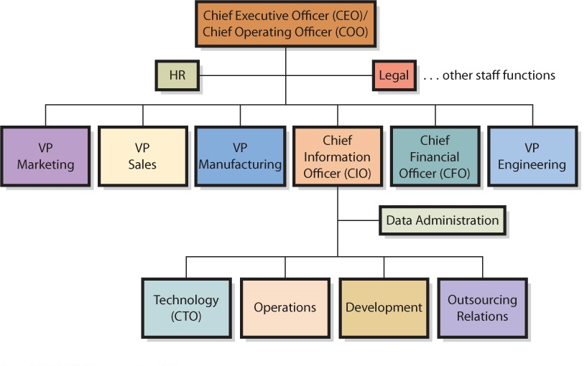
How is the BTM Department Organized?
Notes:
Q1 How is the IT department organized??
Figure 11-1 Typical Top-level Reporting Relationships

Slide 3
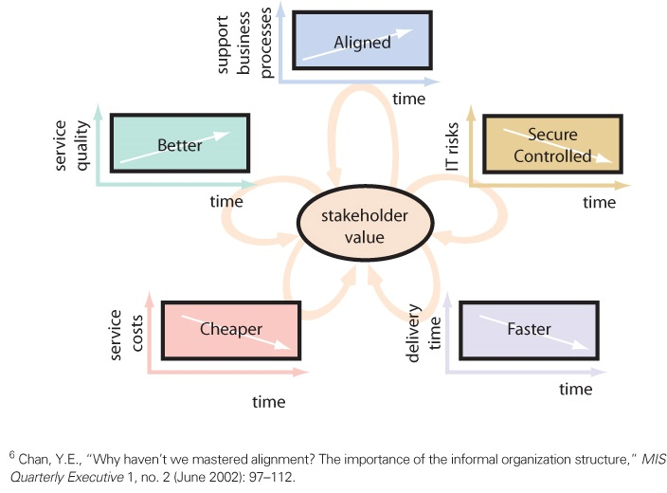
What is BTM Governance?
Goal of BTM governance is to improve the benefits of an organization’s IT investment over time
Notes:
Q5 What is information systems governance?

Slide 4
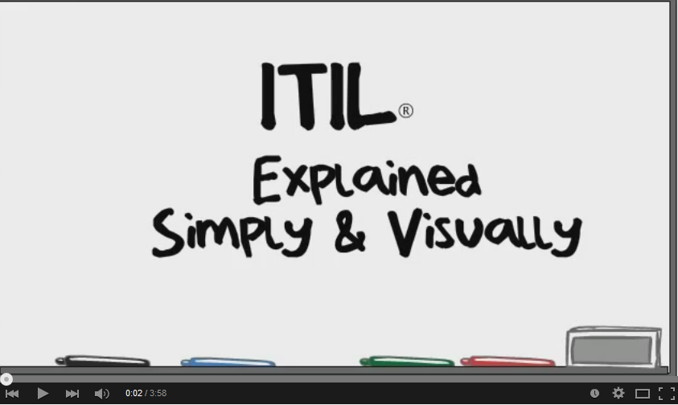
What is Information Technology Architecture?
IT architecture is the basic framework for all the computers, systems, and information management that support organizational services
Information Technology Infrastructure Library (ITIL) is a well-recognized collection of books that provide a framework of best-practice approaches to IT operations
http://youtu.be/vBguassbAzo
Notes:
Q3 What is information technology architecture?

Slide 5
What is IT/Business Alignment, and Why is it Difficult?
Process of matching organizational objectives with IT architecture
Measured as the degree to which the IT department’s missions, objectives, and plans overlap with the overall business missions, objectives, and plans
Communication between business and IT executives is the most important indicator of alignment
http://youtu.be/5b8oSR_Q5Rs
Notes:
Q4 What is alignment, why is it important, and why is it difficult?

Slide 6
Why BTM governance matters to non-BTM managers
Increased need to report and disclose BTM operational information will require employees at all levels of an organization to become more familiar with the issues facing IT management
Senior business managers are required to make assertions about the controls on BTM that will expose them to both financial and criminal penalties
Sarbanes-Oxley Act (USA) and Bill 198 (Ontario) require all publicly-traded companies to certify their controls
Notes:
Q6 What is an information systems audit?

Slide 8
Building Value in the Sarbanes-Oxley Compliance Program
https://youtu.be/Wa7fel6XVqg
Notes:
Q6 What is an information systems audit?

Slide 9
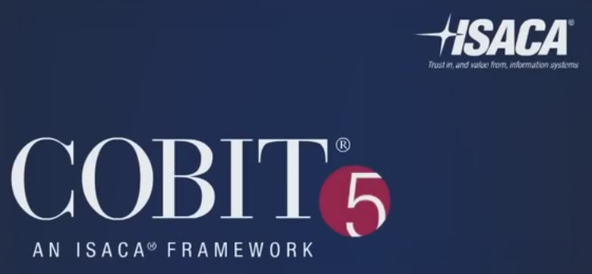
What is an Information Systems Audit?
IS Audit: Examination and verification of a company’s information resources that are used to collect, store, process, and retrieve information – including organization’s IS policies and procedures
Control Objectives for Information and Related Technology (COBIT) is a framework of best practices designed for IT management
http://youtu.be/q7xexHtwSGI
Notes:
Q6 What is an information systems audit?

Slide 10
What Is Green IT?
Green IT, or green computing - using IT resources to better support the triple bottom line for organizations
The triple bottom line - a concept that expands the notion of traditional financial reports, which are based solely on financial performance, to take into account ecological and social performance
Primary goals to improve energy efficiency, promote recyclability, and reduce the use of materials that are hazardous to the environment
http://youtu.be/350Rb2sOc3U
Notes:
Q8 What is green IT and why should I care about it?

Slide 11
Sources
Most of the slides are adapted from COMM 226 Business Technology Management by David M. Kroenke, Andrew Gemino, Peter Tingling, and Earl H. McKinney, Jr. 2nd Custom Edition for Concordia University (2014) published by Pearson Canada. ISBN 13: 978-1-269-96956-7
Other sources are noted on the slides themselves

