Slide 1
COMM 226 Hardware
Chitu Okoli
Associate Professor in Business Technology Management
John Molson School of Business, Concordia University, Montréal

Slide 2
Types of computers
Sources:
https://upload.wikimedia.org/wikipedia/commons/d/d3/IBM_Blue_Gene_P_supercomputer.jpg
https://upload.wikimedia.org/wikipedia/commons/2/21/Front_Z9_2094.jpg
https://upload.wikimedia.org/wikipedia/commons/f/f5/Rack001.jpg
http://bacikgroup.com/wp-content/uploads/2013/11/server-farm-shot.jpg
http://sameeroostatics.meethi.com/spex_1021208898_650.png
http://www.admiralmarkets.com/images/mtmac/MetaTrader4-for-Mac-OS.png
https://www.apple.com/macbook-air/images/design_unibody2.jpg
http://www.laptopjoy.com/wp-content/uploads/2009/10/laptop-computer-and-best-buy9.jpg
http://static.digit.in/fckeditor/besttablets2013.jpg
http://actu.meilleurmobile.com/wp-content/uploads/2014/07/smartphones3.jpg

Slide 3
Supercomputer

Slide 4
Mainframe

Slide 5
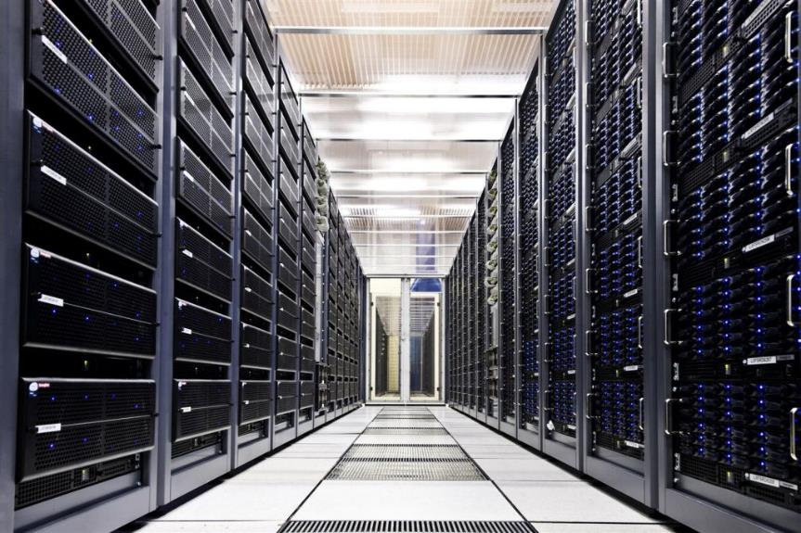
Servers and server farms

Slide 6
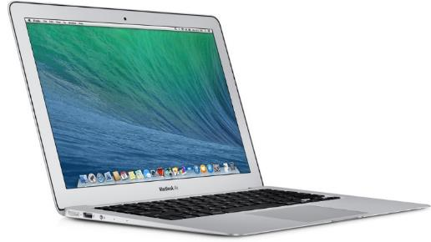
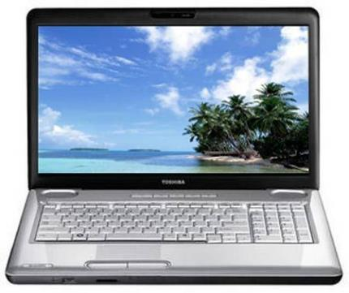
Desktop and laptop computers

Slide 7
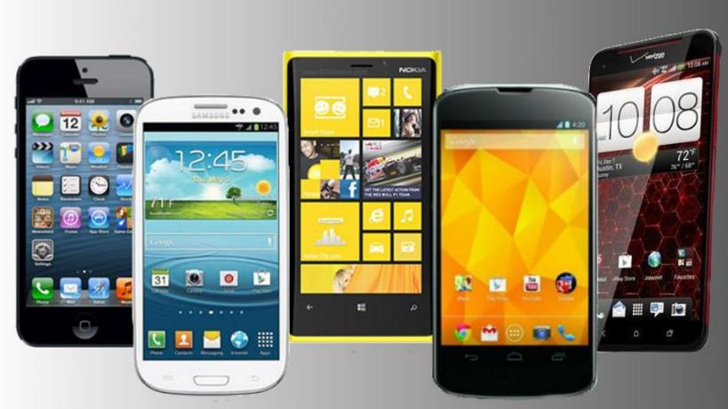
Tablets and smartphones

Slide 8
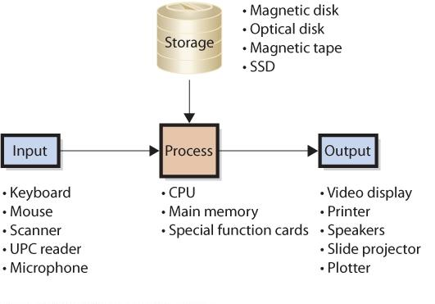
Inside a computer
http://computer.howstuffworks.com/23-computer-tour-video.htm

Slide 9
Computer data sizes

Slide 10
Computer memory basics
Computers are digital, and represent data in bit patterns
Bit is shorthand for Binary digIT. The binary system consists of two values: 0 and 1
8 bits = 1 byte
Bytes are the basic measure of storage in computers
ASCII Code (8 bits) and Unicode (usually 8 or 16 bits) assign a unique character to each pattern of 0s and 1s in a byte

Slide 11
Kilobytes, megabytes, etc.
Source: https://en.wikipedia.org/wiki/Template:Quantities_of_bytes

Slide 12
How computers represent data
0 or 1: One bit
Characters are represented by one byte
The word, CANADA, is represented by six bytes in ASCII encoding:
C | 0 | 1 | 0 | 0 | 0 | 0 | 1 | 1
A | 0 | 1 | 0 | 0 | 0 | 0 | 0 | 1
N | 0 | 1 | 0 | 0 | 1 | 1 | 1 | 0
A | 0 | 1 | 0 | 0 | 0 | 0 | 0 | 1
D | 0 | 1 | 0 | 0 | 0 | 1 | 0 | 0
A | 0 | 1 | 0 | 0 | 0 | 0 | 0 | 1
Notes:
Mention NIBBLES: similar first 4 bits for all capital letters
The last 4 bits represent the position of the letter in the alphabet, in binary
(e.g. 0001 (binary) = 1 (base10) and A is the 1st letter)

Slide 13
Some hardware decisions

Slide 16
Sources
Most of the slides are adapted from COMM 226 Business Technology Management by David M. Kroenke, Andrew Gemino, Peter Tingling, and Earl H. McKinney, Jr. 2nd Custom Edition for Concordia University (2014) published by Pearson Canada. ISBN 13: 978-1-269-96956-7
Other sources are noted on the slides themselves

