Slide 1
COMM 226 Careers in Business Technology Management
Chitu Okoli
Associate Professor in Business Technology Management
John Molson School of Business, Concordia University, Montréal

Slide 2
Pure commerce vs. Conscientious commerce
Pure commerce
Buy low, sell high, leave ’em dry
Conscientious commerce
It’s all about creating value for people
Every transaction must be a good deal for the other person
You’d rather be cheated than to cheat anyone
We need to take care of our conscience

Slide 3
Conscientious commerce: People are more valuable than money
We should treat other people how we would like to be treated if we were in their shoes
The greatest person is the one who helps the most people
Helping people is valuable. Money is only a tool for helping people; it should never replace people's worth.
We need to take care of our conscience

Slide 4
Conscientious commerce: Employees are more valuable than customers
Our fellow employees are the real people we deal with every day and long term; customers are primarily means to an end.
Taking proper care of employees will make them happy, and this will make customers happy, too.
Organizational profitability should primarily be a means to give employees a good livelihood.
Sacrificing employees for the sake of customers is driven by the love of money. It replaces happy employees with more money.
We need to take care of our conscience

Slide 5
Stupid career advice: Two opposite extremes
“Follow your heart; just do what you love.”
“Pick something that will make you a lot of money; you’ll learn to love it eventually. Even if you don’t, then you can do what you love when you retire early.”

Slide 6
Stupid career advice #1: “Just do what you love”
Fundamentally selfish
You only care about what you love, not what other people need
Blind and foolish
A long train of artists, humanity students, and even PhD scientists have been burnt by this idealistic perspective
Art, humanities and science all have value, but it is unwise to pursue them for their own sake: focus on other people’s needs

Slide 7
Stupid career advice #2: “Just go after the money”
Fundamentally dehumanizing
You dehumanize yourself into a money machine
You dehumanize other people as money makers for you
Empty and unfulfilling
You might make money, but you will never be satisfied

Slide 8
More balanced career advice
Do something that you enjoy
You don’t have to love it, but you have to at least enjoy it
If you start out enjoying it, you will likely grow to love it
If you enjoy it, you can likely become good at it
Do something that other people consider valuable
This makes you focused on helping other people, not just yourself
If others find it valuable, then they’ll be willing to pay you to do good work
It has to be sufficiently valuable to earn you a living—you don’t have to get rich, but you need to earn a living

Slide 9
What does a typical BTM job look like?
http://youtu.be/yiaqoAGEhi8

Slide 10
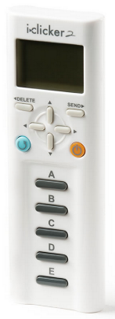

Slide 11
What kind of person could be good at BTM?
You have to enjoy using IT and learning how to use new IT
Your job never gets boring and routine
You’re always learning and expanding your skills
You have to enjoy the challenge of helping people solve their problems
It’s not about the technology; it’s about the people
You’re the kind of person that doesn’t rest until you’ve solved the puzzle
BTM isn’t just about business—it’s about healthcare, government, education, non-profits—any and every kind of organization

Slide 13
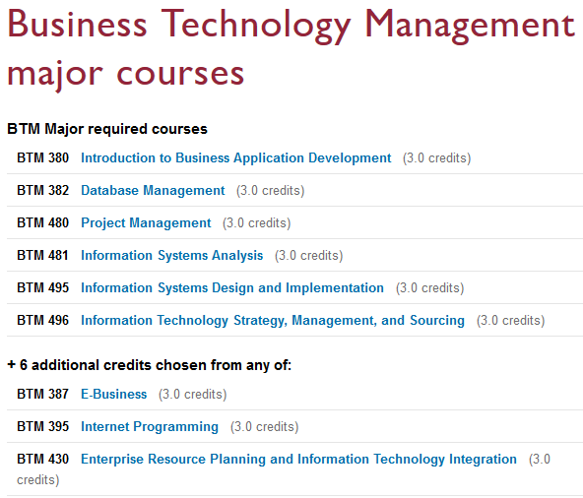
JMSB BTM Major and Minor
BTM Minor

