Slide 1
Post-Module WordPress 3-5
BTM 395: Internet Programming

Slide 2
WordPress.com vs. WordPress.org
[Top Hat exercise]

Slide 3
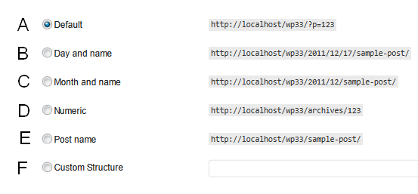
Permalink structure
[Top Hat]
Go to the WP Dashboard | Settings | Permalinks
Which option do you like best?

Slide 4
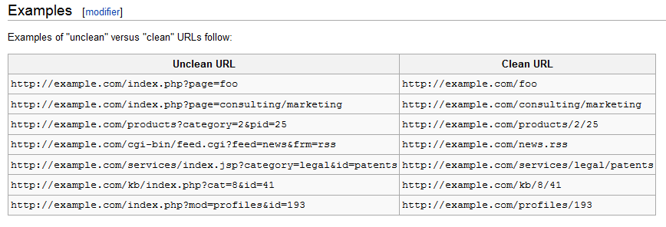
Unclean vs. Clean URLs
https://en.wikipedia.org/wiki/Clean_URL

Slide 5
SEO-friendly (“clean”) URLs
More human-readable, when humans read them
Higher ranking on search engines because of keywords
Custom permalink: /%category%/%postname% maximizes keywords in URL

Slide 6
WordPress Missing Manual chapter 8: Comments: Letting Your Readers Talk Back

Slide 7
Comments: allow or forbid?
Comments bring your site into Web 2.0: user interactivity
Crucial for making your site sticky
Discussion between you and your visitors
Your visitors get to meet each other
Human relationships create attachment to the website

Slide 8
Comment options
Moderation
Moderated: comments posted only if explicitly approved
Unmoderated: comments posted immediately on submission
Registration of commentators
Anonymous: Anyone can comment without restrictions
Submit e-mail: Anyone can comment, but must submit name and e-mail address
E-mail not verified, but used as unique ID
Registration required: Only registered users can submit comments
Open registration: Anyone can create an account
Closed registration: Registration only after approval or invitation

Slide 9
SPAM, SPAM, SPAM, SPAM, SPAM, SPAM, SPAM, SPAM, SPAM, SPAM, SPAM, SPAM, SPAM, SPAM,
Option: Forbidding comments
You might decide to forbid comments, but shouldn’t be just because of spammers
Option: Moderation of comments
OK for small sites, but becomes unmanageable as the site grows
Option: Requiring login to submit comments
Drastically cuts number of people willing to comment
Best solution: Antispam plugin
Akismet is free (though requires registration)
Works similarly to e-mail antispam

Slide 10
[Activity: setup comment options]

