Slide 1
BTM 382 Database Management Chapter 13: Business intelligence and data warehousing Chapter 14-4: Data analytics
Chitu Okoli
Associate Professor in Business Technology Management
John Molson School of Business, Concordia University, Montréal

Slide 2
Structure of BTM 382 Database Management
Week 1: Introduction and overview
ch1: Introduction
Weeks 2-6: Database design
ch3: Relational model
ch4: ER modeling
ch6: Normalization
ERD modeling exercise
ch5: Advanced data modeling
Week 7: Midterm exam
Weeks 8-10: Database programming
ch7: Intro to SQL
ch8: Advanced SQL
SQL exercises
Weeks 11-13: Database management
ch2,12,14: Data models
ch13: Business intelligence and data warehousing
ch9,15,16: Selected managerial topics

Slide 3
Review of Chapter 13: Business intelligence and data warehousing
What is the scope of business intelligence?
What are the most important differences between an operational database and a data warehouse?
What are the important structural components of a data warehouse?

Slide 4
Business intelligence

Slide 5
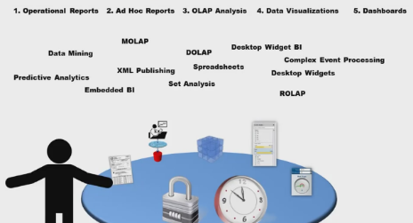
Business intelligence (BI)
Comprehensive, cohesive, integrated set of tools and processes
Captures, collects, integrates, stores, and analyzes data
Purpose is to generate and present information to support business decision making
https://youtu.be/LFnewuBsYiY

Slide 6
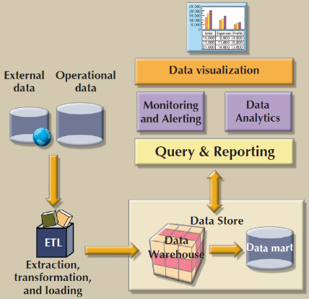
Business intelligence framework

Slide 7
Operational databases vs. Data warehouses

Slide 8
Operational data vs. Decision support data
Operational data
Optimized to support transactions representing daily operations (creating, reading, updating, and deleting records)
Stored in relational database with highly normalized structures
Seldom well-suited for decision support tasks
Decision support data
Optimized to support advanced reporting (read-only queries)
Supports decisions by helping managers quickly see the big picture (roll up) and digging into the details (drill down), back and forth as needed
Effectiveness of BI depends on quality of data gathered at operational level

Slide 9
Operational databases vs. Data warehouses
https://youtu.be/n63KXf0ixis

Slide 10
Comparison of operational databases with data warehouses
Both use the relational model (based on tables linked by foreign keys), but
Operational databases use the entity-relationship model to think about its tables, whereas
Data warehouses use the star schema to think about its tables
Both use relational databases that work with SQL, but
Operational databases are optimized both for frequent read and write operations, whereas
Data warehouses are optimized for intensive read-only operations with no regular writes
Both assure data integrity, but
Operational databases enforce transaction integrity during its frequent write operations (this slows them down), whereas
Data warehouses don’t need to check for integrity during regular operations, only during periodic data updates

Slide 11
Notes:
B
A

Slide 12
Links to the videos from this slide are on the last slide in this presentation (Sources)

Slide 13
Some technical details about data warehouses

Slide 14
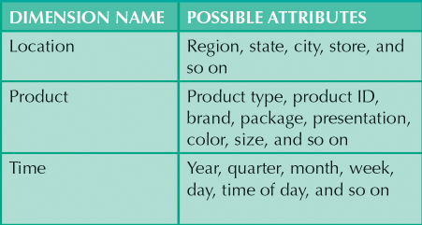
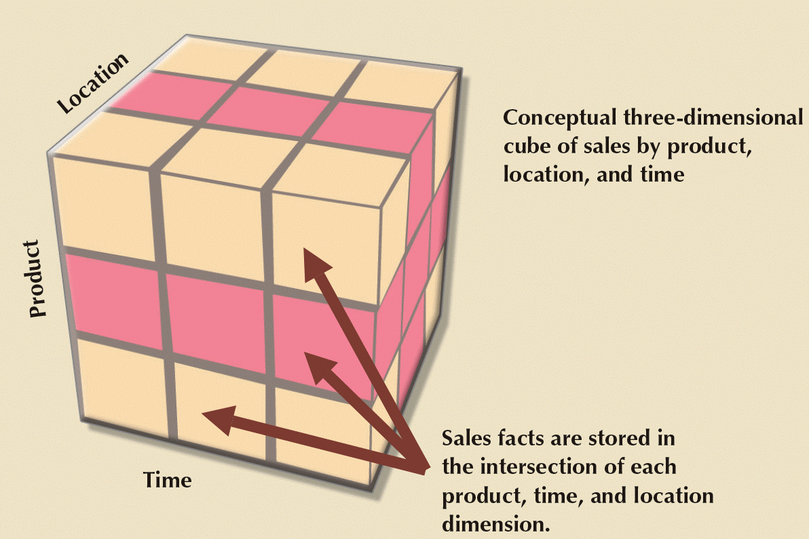
Star schema—data model for data warehouses

Slide 15
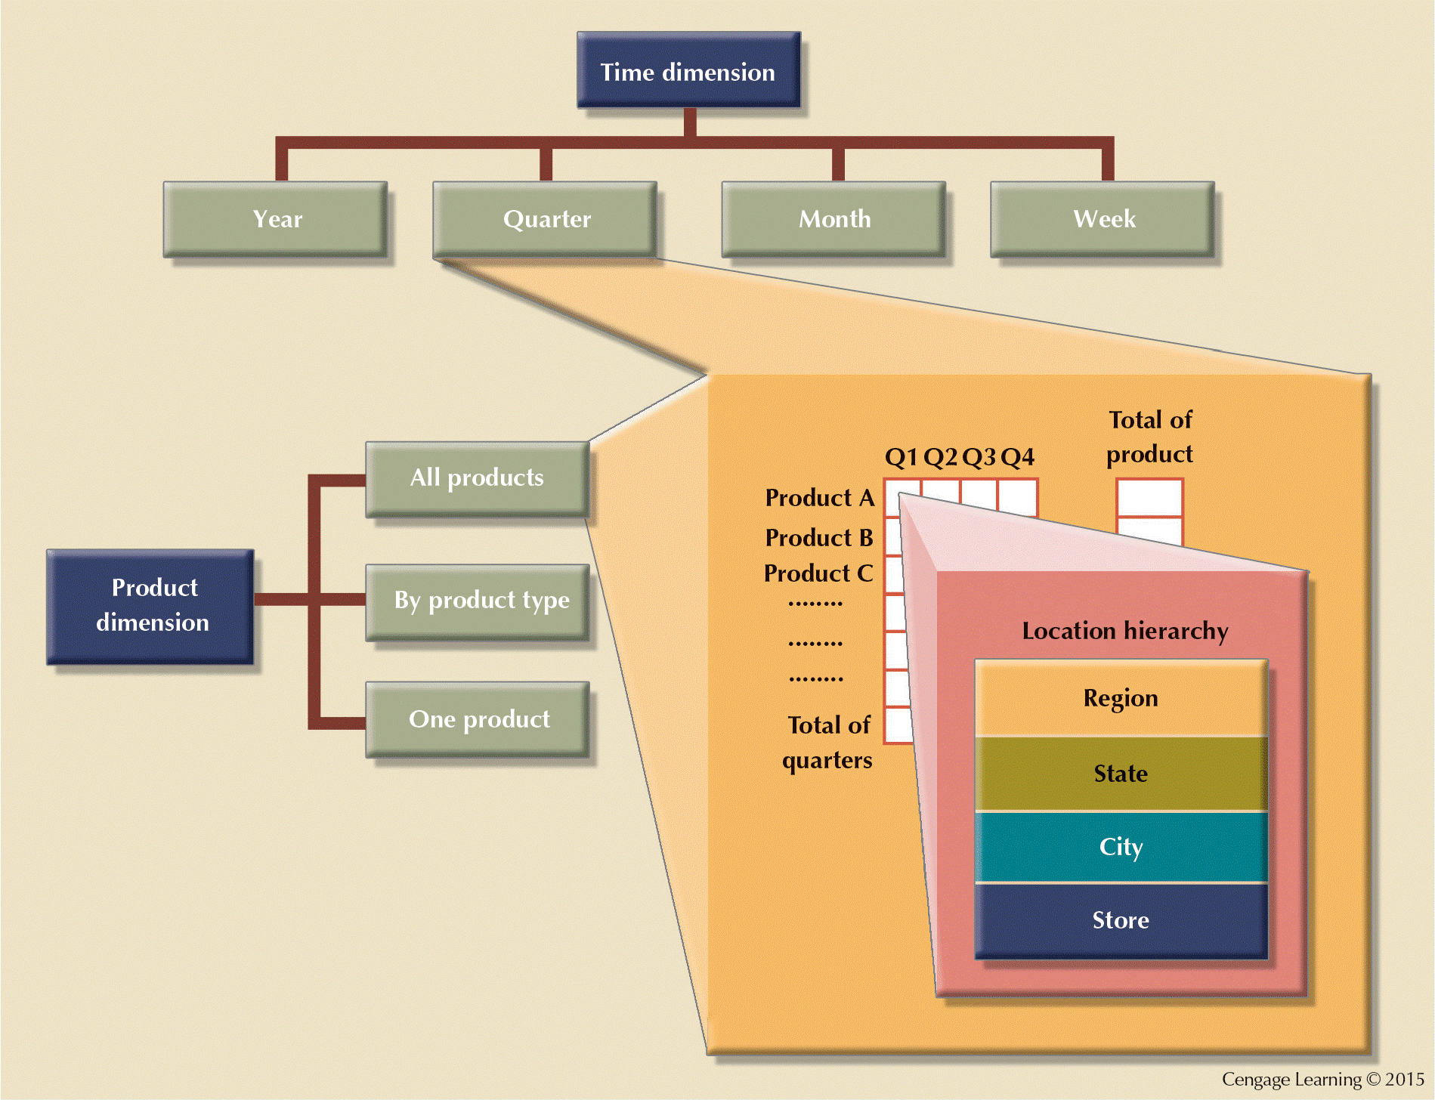
Attribute hierarchies and relational table representation

Slide 16
Star schema vs normalized database
https://youtu.be/q77B-G8CA24

Slide 17
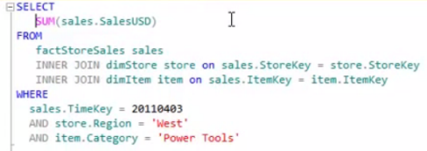
Simplified queries for star schema
Normalized database (partial view)
Star schema (simplified, partial view)
Notes:
Imagine how complex the same query would have been in the normalized transactional database on the left!

Slide 18
Online analytical processing (OLAP)
https://youtu.be/2ryG3Jy6eIY

Slide 19
Summary

Slide 20
Summary of Chapter 13: Business intelligence and data warehousing
Business intelligence is a comprehensive set of tools and processes to support business decisions with data.
Although both are based on relational database technology, operational databases are fundamentally different from data warehouses.
A data warehouse uses the star schema as a data model optimized for obtaining rapid results to queries.

Slide 22
Sources
Introduction to Pivot Tables, Charts, and Dashboards in Excel:
Part 1: https://youtu.be/9NUjHBNWe9M
Part 2: https://youtu.be/g530cnFfk8Y
Most of the slides are adapted from Database Systems: Design, Implementation and Management by Carlos Coronel and Steven Morris. 11th edition (2015) published by Cengage Learning. ISBN 13: 978-1-285-19614-5
Other sources are noted on the slides themselves

