Slide 1
BTM 382 Database Management Chapter 8 Advanced SQL
Chitu Okoli
Associate Professor in Business Technology Management
John Molson School of Business, Concordia University, Montréal

Slide 2
Structure of BTM 382 Database Management
Week 1: Introduction and overview
ch1: Introduction
Weeks 2-6: Database design
ch3: Relational model
ch4: ER modeling
ch6: Normalization
ERD modeling exercise
ch5: Advanced data modeling
Week 7: Midterm exam
Weeks 8-10: Database programming
ch7: Intro to SQL
ch8: Advanced SQL
SQL exercises
Weeks 11-13: Database management
ch2,12,14: Data models
ch13: Business intelligence and data warehousing
ch9,15,16: Selected managerial topics

Slide 3
Review of Chapter 8: Advanced SQL
What are the main join operators in SQL?
How do you create a subquery?
What are some important Oracle SQL functions?
What are some important advanced SQL features to know about?

Slide 4
SQL Join Operators

Slide 5
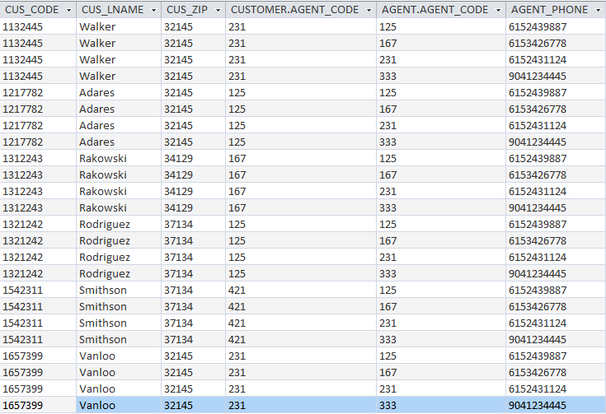
Cross join
SELECT *
FROM CUSTOMER, AGENT

Slide 6
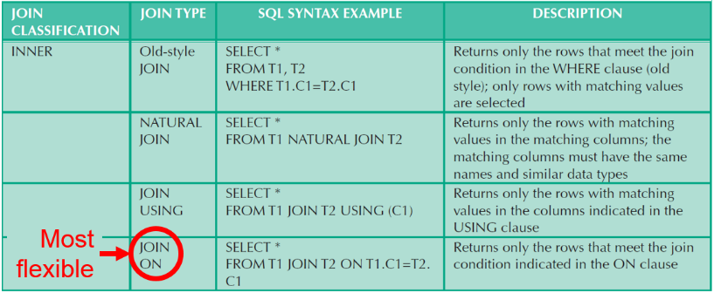
Inner joins: natural join, join using, join on

Slide 7
Inner joins: natural join, join using, join on
Old-style JOIN:
SELECT *
FROM CUSTOMER, AGENT
WHERE CUSTOMER.AGENT_CODE = AGENT.AGENT_CODE;
NATURAL JOIN :
SELECT * FROM CUSTOMER NATURAL JOIN AGENT;
JOIN USING:
SELECT *
FROM CUSTOMER JOIN AGENT USING (AGENT_CODE);
JOIN ON:
SELECT *
FROM CUSTOMER JOIN AGENT ON CUSTOMER.AGENT_CODE = AGENT.AGENT_CODE;

Slide 8
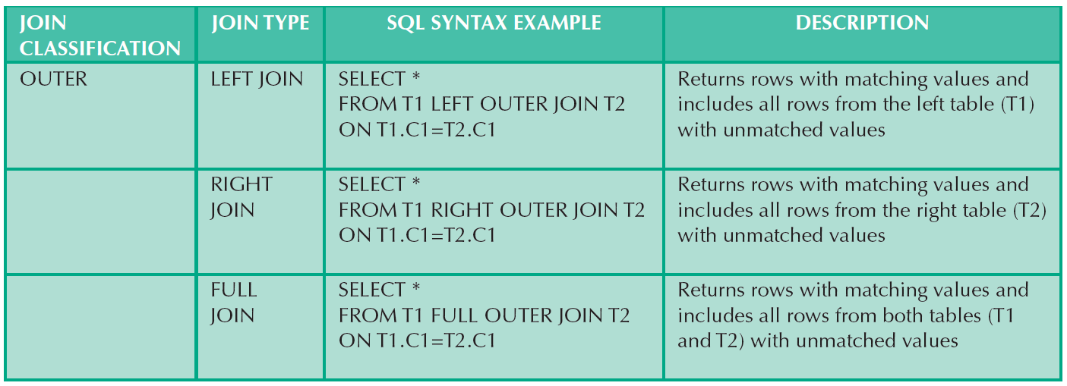
Outer joins

Slide 9
Left outer join, Right outer join, Full outer join
CUSTOMER left outer join AGENT
CUSTOMER right outer join AGENT
CUSTOMER full outer join AGENT

Slide 10
Subqueries

Slide 11
Order of creating queries
SELECT column list (required)
Optional clauses:
WHERE conditions
GROUP BY aggregation
ORDER BY sort order
FROM tables (required)
If there is any clause that cannot be easily obtained, then perhaps you need a subquery
Rather than considering what type of subquery you’re dealing with, simply build the subquery in little pieces

Slide 12
Possible results from a SELECT query
0. NULL: No results found
Any of the examples from below might result in NULL
Single value: Intersection of one column and one row
List of same-type values: One column of values (same datatype)
Might be one column, multiple rows
Might be one column, one row (special case of #1 above)
NOT a row of values (that would be a special case of #3 below)
One column means that all values have the same datatype
One row means that each value has different datatypes
Virtual table of values: Multiple columns and multiple rows
Might be multiple columns, multiple rows
Might be multiple columns and only one row
Might be only one column and multiple rows (special case of #2 above)
Might be only one column and only one row (special case of #1 above)

Slide 13
Single value: Intersection of one column and one row

Slide 14
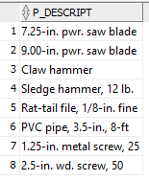
List of same-type values: One column of values (same datatype)
Might be one column, multiple rows
Might be one column, one row (special case of #1 above)
NOT a row of values (that would be a special case of #3 below)
One column means that all values have the same datatype
One row means that each value has different datatypes

Slide 15
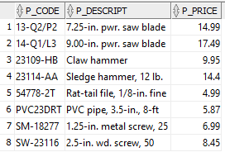
Virtual table of values: Multiple columns and multiple rows
Might be multiple columns, multiple rows
Might be multiple columns and only one row
Might be only one column and multiple rows (special case of #2 above)
Might be only one column and only one row (special case of #1 above)

Slide 16
Building subqueries the easy way
Don’t think about subqueries; just first try to build a query
If the query needs an unknown value from the database to complete it, then you need an inner query to get that missing value.
OK, so you need a subquery. No big deal.
What type of missing value do you need? This determines the kind of SELECT query you need for the inner query:
If you need a single value: Inner query returns one column with a unique row
e.g. using a WHERE or HAVING clause, or in an attribute list
If you need a list of values of the same type: Inner query returns one column with one or more rows
e.g. as the input to the IN, ALL, or ANY operators
If you need a virtual table: Inner query returns multiple columns and one or more rows
e.g. as the input to the FROM clause

Slide 17
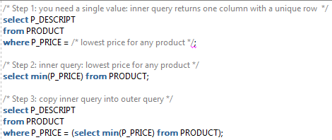
Building subqueries the easy way
If you need a single value: Inner query returns one column with a unique row
e.g. using a WHERE or HAVING clause, or in an attribute list

Slide 18
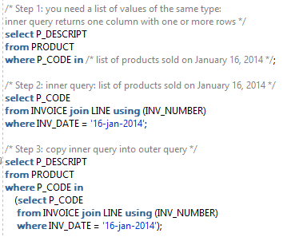
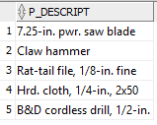
Building subqueries the easy way
If you need a list of values of the same type: Inner query returns one column with one or more rows
e.g. as the input to the IN, ALL, or ANY operators

Slide 19
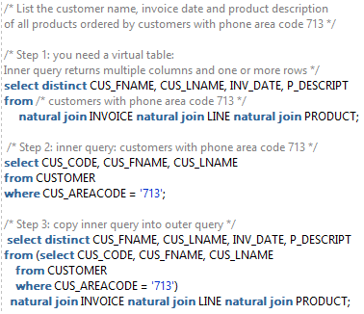
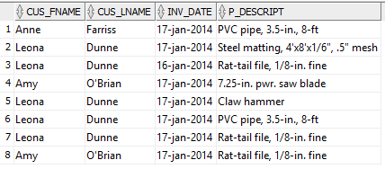
Building subqueries the easy way
If you need a virtual table: Inner query returns multiple columns and one or more rows
e.g. as the input to the FROM clause

Slide 20
Multirow subquery operators: ALL, ANY and SOME
Allow comparison of single value with a list of values using inequality comparison
“> ALL” means “greater than the maximum in list”
So, it’s clearer to use > MAX(SELECT …)
“< ALL” means “less than minimum in the list”
So, it’s clearer to use < MIN(SELECT …)
Using “= ANY” operator is equivalent to IN operator
So, it’s clearer to use IN
SOME is exactly the same thing as ANY
I recommend: don’t use ALL, ANY or SOME, since they have very particular meanings and might confuse people who read your code
But here’s a great, detailed explanation of how they work

Slide 21
SQL Functions

Slide 22
Regular functions versus Aggregate functions
Regular functions (chapter 8)
Input: one or more single values (possibly various datatypes)
Output: one single value
E.g. ADD_MONTHS(OrderDate, 2), SUBSTR(Phone,1,3)
Aggregate or group functions (chapter 7)
Input: one single column of values (list all of the same datatype)
Output: either
One single value for an entire table; or
One single value per row, if GROUP BY clause is used
E.g. SUM(SalesTotal), AVG(Age)
COUNT
COUNT(*): Use this most of the time, to count all rows
COUNT(Attribute): Will count rows for that attribute only if they are not NULL

Slide 24
Case-insensitive search:
select FIRSTNAME, LASTNAME
from EMPLOYEE
where LOWER(LASTNAME) = 'smith';
You could also use
where UPPER(LASTNAME) = 'SMITH'
Either of these would match 'Smith‘. Otherwise, they would not match, since string search is case-sensitive by default

Slide 26
Other Advanced SQL Elements

Slide 27
Views
A view is a named, saved query
A virtual table (multiple columns and rows): it can be used wherever a table is expected
Always up-to-date, because it is a query, not a real table
A view’s data is not saved to the database; rather, the SQL query for the view is executed each time it is called
Updatable view
“Updatable” means that it can receive all the CRED DML operations:
Create: INSERT
Read: SELECT (all views can receive the SELECT operation)
Edit: UPDATE
Delete: DELETE
Basic condition to be updatable: the view (saved query) includes a proper primary key and is in 1NF
But some other conditions must apply for a view to be updatable
If a view does not meet these conditions, then it is not updateable, and it can only receive the SELECT operation

Slide 28
Stored procedures
Stored procedures and stored functions
Add 3rd generation programming features to SQL (e.g. if-then, while loops, etc.)
Procedure vs. function: A function returns a value, whereas a procedure does not—that’s the only difference
Triggers
Stored procedure code that is automatically invoked by DBMS on DML events
Enables event-driven programming in the DBMS
Each DBMS has its own stored procedure language
Oracle: Procedural SQL (PL/SQL)
Microsoft Access: Visual Basic for Applications (VBA)
Microsoft SQL Server: Transact SQL (T-SQL)
MySQL: MySQL stored procedures

Slide 29
Oracle Sequences
Oracle sequences
Independent object in the database: you can create and delete them at any time
Very flexible tool for implementing automatic numbering
Autonumber in Oracle
Old way (before Oracle version 12c, including 11g): sequences + triggers
New way (Oracle 12c): IDENTITY data type

Slide 30
Summary of Chapter 8: Advanced SQL
The main join operators are the cross join, inner joins and outer joins
To create a subquery, you need to understand the possible results of a query and then know where to place them within a compound query
Among other Oracle SQL functions and features, it is important to know ||, TO_DATE, UPPER/LOWER, CASE and SWITCH
Views, stored procedures and Oracle sequences are some important advanced SQL features to know about

Slide 32
Sources
Many of the slides are adapted from Database Systems: Design, Implementation and Management by Carlos Coronel and Steven Morris. 11th edition (2015) published by Cengage Learning. ISBN 13: 978-1-285-19614-5
Other sources are noted on the slides themselves

