Slide 1
BTM 382 Database Management Chapter 14.3-4: XML and cloud databases Chapter 9.3: Database design Chapter 15.1-6: Database administration
Chitu Okoli
Associate Professor in Business Technology Management
John Molson School of Business, Concordia University, Montréal

Slide 2
Structure of BTM 382 Database Management
Week 1: Introduction and overview
ch1: Introduction
Weeks 2-6: Database design
ch3: Relational model
ch4: ER modeling
ch6: Normalization
ERD modeling exercise
ch5: Advanced data modeling
Week 7: Midterm exam
Weeks 8-10: Database programming
ch7: Intro to SQL
ch8: Advanced SQL
SQL exercises
Weeks 11-13: Database management
ch2,12: Data models
ch13: Business intelligence and data warehousing
ch9,14,15: Selected managerial topics

Slide 3
Review of Selected managerial topics
How is XML useful for data management?
What are the implications of using cloud databases?
What are some key, important elements of database design?
What are some key, important elements of database administration?

Slide 4
XML Chapter 14.3

Slide 5
Extensible Markup Language (XML)
Metalanguage to represent and manipulate data elements
Facilitates exchange of structured documents over the Web

Slide 6
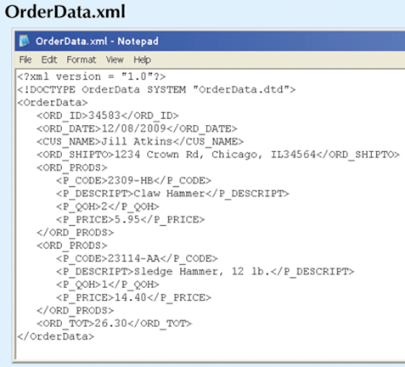
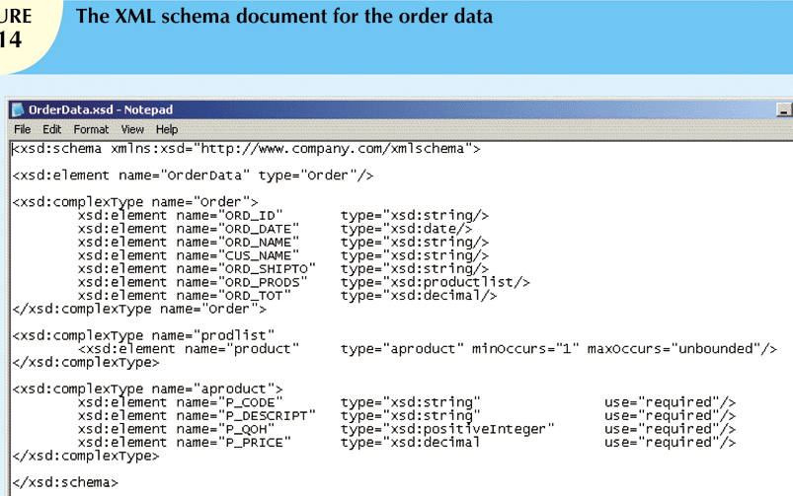

Slide 7
XML Applications
B2B exchanges
Legacy systems integration
Web page development
Database support
Database meta-dictionaries
XML databases
XML services
Standards-compliant documents

Slide 8
Notes:
B
A

Slide 9
XML example:

Slide 10
Cloud databases Chapter 14.4

Slide 11
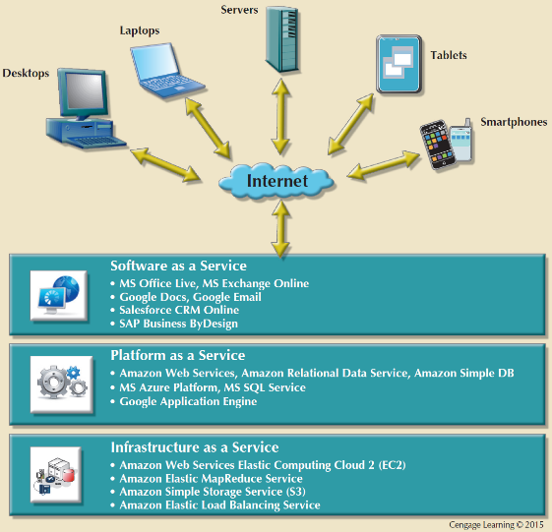
Types of cloud services
http://youtu.be/SgujaIzkwrE

Slide 12
Cloud databases
Execute the database on the cloud, accessed through web browsers
The cloud provider takes care of installation, performance tuning and maintenance
The organization’s DBA is still responsible for database design and configuration
Two general approaches:
DBMS vendor’s cloud: E.g. Oracle on Oracle Cloud or IBM DB2 on IBM Cloud
General cloud service provider. E.g. Oracle on Amazon Cloud or MySQL on Microsoft Azure Cloud

Slide 13
Notes:
B
A

Slide 14
Top two myths about cloud computing
“Cloud computing is less secure; it’s more vulnerable to hackers because it’s on the Internet”
Assumption: It is harder for a hacker to attack your private infrastructure than it is to attack a cloud provider
The opposite is true: good cloud providers are top-notch security experts, probably much better than your organization will ever be
If your data is connected to the Internet, then it is probably safer with a high-quality professional cloud provider than it is with you
BUT: You must do due diligence to make sure that the cloud provider you’ve chosen is truly secure: https://youtu.be/9mLMhNhDY6w
BUT: PRIVACY is a genuine and serious concern: you have to decide if you trust the cloud provider with your private data
“Cloud computing is less reliable; if you lose your Internet connection, you can’t do anything”
Assumption: You can still work productively in your organization if the Internet is down
In fact, we are so dependent on the Internet today that properly managed organizations with enterprise-level ISPs should have very little Internet downtime

Slide 15
Database design Chapter 9.3

Slide 16
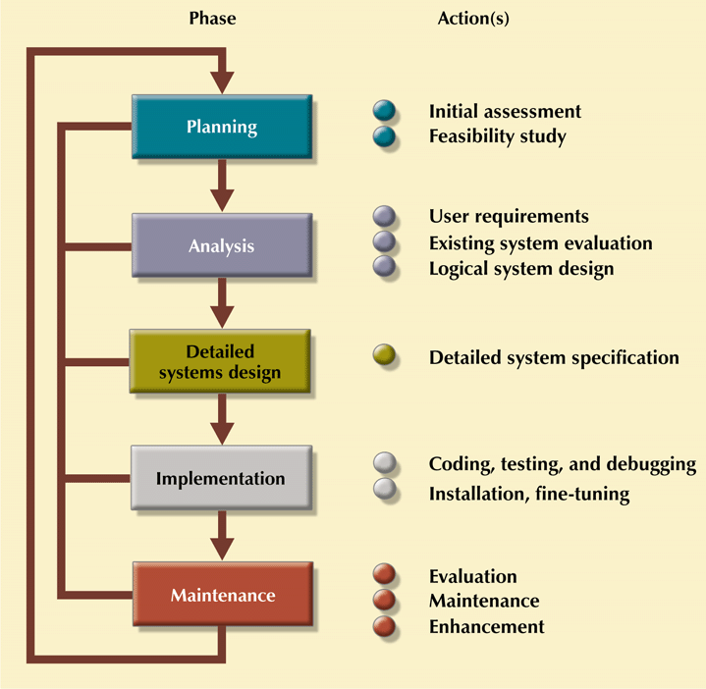
JMSB BTM and the Systems Development Life Cycle (SDLC)
Entire SDLC
BTM Minor

Slide 17
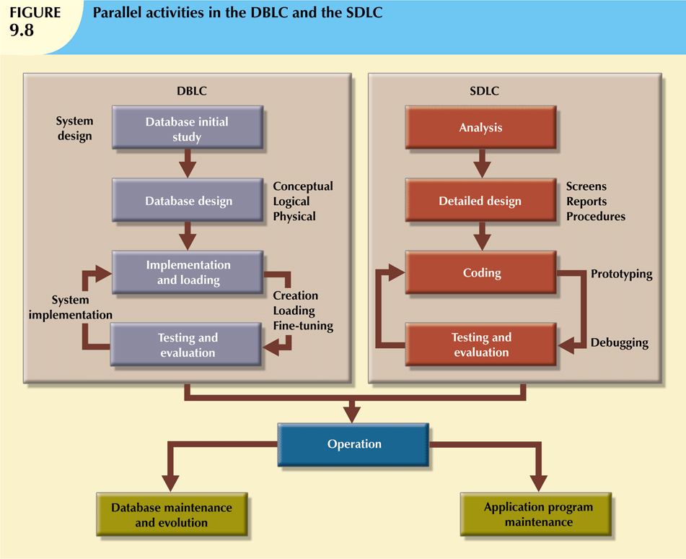
The Database Life Cycle (DBLC)
Six phases:
Database initial study
Database design
Implementation and loading
Testing and evaluation
Operation
Maintenance and evolution

Slide 18
Which DBMS should you choose?
Relational or not?
Relational: 90% of professional situations
Object-oriented: complex data structures
NoSQL: vast amounts of unstructured data
Proprietary or open source?
Proprietary: higher price, but better vendor support
Open source: lower price, community support, customizable database code
Self-hosted or cloud?
Self-hosted: you need to have great DBA and infrastructure
Cloud: focus on database performance, not administration, but privacy and outsourcing implications
Popularity ranking of DBMSs: http://db-engines.com/en/ranking

Slide 19
Database administration Chapter 15.1-6

Slide 21
Data security
http://youtu.be/ZWbwxWziXcE

Slide 22
DBA’s role in the Cloud
Reduced role in installing and maintaining the DBMS, because the cloud services provide:
DBMS installation and updates
Server/network management
Backup and recovery operations
However, DBA is still responsible for:
Database design
User account configuration
Security policies
Application programmers are still responsible for:
Database coding (SQL)

Slide 23
Summary

Slide 24
Summary of Selected managerial topics
XML is useful for sharing textual data in a structured, highly compatible format.
Cloud databases offer numerous advantages, though security and privacy shouldn’t be taken for granted.
The DBLC provides best practices for database design
Database administration is simplified by cloud computing, but design and programming are still particularly important.

Slide 26
Sources
Most of the slides are adapted from Database Systems: Design, Implementation and Management by Carlos Coronel and Steven Morris. 11th edition (2015) published by Cengage Learning. ISBN 13: 978-1-285-19614-5
Other sources are noted on the slides themselves

