Slide 1
BTM 382 Database Management Chapter 4: Entity Relationship (ER) Modeling
Chitu Okoli
Associate Professor in Business Technology Management
John Molson School of Business, Concordia University, Montréal

Slide 2
Structure of BTM 382 Database Management
Week 1: Introduction and overview
ch1: Introduction
Weeks 2-6: Database design
ch3: Relational model
ch4: ER modeling
ch6: Normalization
ERD modeling exercise
ch5: Advanced data modeling
Week 7: Midterm exam
Weeks 8-10: Database programming
ch7: Intro to SQL
ch8: Advanced SQL
SQL exercises
Weeks 11-13: Database management
ch2,12,14: Data models
ch13: Business intelligence and data warehousing
ch9,15,16: Selected managerial topics

Slide 3
Review of Chapter 4: ER Modeling
What are the different kinds of attribute and how do you implement them in a database?
How do different business rules reflect different properties of relationships and entities in an ER model?
What are some important ERD design considerations?

Slide 4
Attributes

Slide 5
Composite vs. simple attributes
Composite attributes can be subdivided into composite parts
e.g. Address → StreetNumber, StreetName, City, Province, etc.)
Not to be confused with a composite key! (a key composed of multiple attributes)
Simple attributes cannot be meaningfully subdivided further (e.g. StreetNumber, City, Province)

Slide 6
Multivalued vs. single-value attributes
Single-value attributes can have only a single value
e.g. a person can have only one Name, DateOfBirth, SIN
Even though Name is a composite attribute (it can be divided into FirstName, LastName), it is single-valued because a person still has only one name
Multivalued attributes can have many values
e.g. one person can have many multiple values of Email: personal e-mail address, work e-mail address
Even though Email is a simple attribute (indivisible), it is multivalued because a person can have multiple e-mail addresses

Slide 7
Implementing multivalued attributes
Multivalued attributes cannot be implemented explicitly in a physical RDBMS. There are two possible implementations:
Create several new attributes for each of the original multivalued attributes’ components (if there is a known, limited number of options)
E.g. HomeAddress, WorkAddress, MailingAddress
Drawback: will leave many nulls in table, especially if the attribute is composite, like Address
Create new entity composed of original multivalued attributes’ components (if there are many options, or number of options is unpredictable)
E.g. Address table with attributes AddressID, AddressType (e.g. Home, Work, Mailing), Street, City, Province, PostalCode
Drawback: extra table complicates database design and queries
The database designer has to decide the best option for their specific database scenario

Slide 8
Relationships and entities

Slide 9
Properties of relationships
Connectivity: 1:1, 1:M or M:N
Degree: how many entities involved in the relationship
unary/recursive, binary, ternary, n-degree
Strength:
Strong (identifying) relationship if one entity is weak
Weak (non-identifying) relationship if both entities are strong

Slide 10
Properties of entities in relationships
Cardinality: minimum and maximum number of entities on each side
e.g. (0,1), (1,1), (1,20), etc.
Participation
Mandatory (at least one entity required—minimum cardinality of 1)
Optional (entity not required—minimum cardinality of 0)
Entity strength/Existence-dependence:
Strong (existence-independent): can exist without the other entity
Weak (existence-dependent): cannot exist without the other entity
Technically, a weak entity is one where the PK of the existence-dependent entity includes the FK from the existence-independent entity, which is usually, but not always, the case

Slide 11
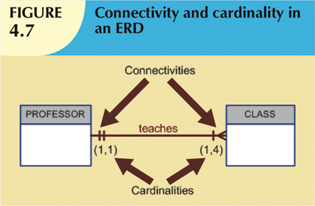
Connectivity and Cardinality
Connectivity
Describes the relationship classification
Three types: 1:1, 1:M, M:M (also called M:N)
Cardinality
Expresses minimum and maximum number of entity occurrences associated with one occurrence of related entity
“1” in 1:1 or 1:M actually means 0 or 1 minimum and 1 maximum
“M” in 1:M or M:M actually means 0 or 1 minimum and either a fixed maximum or ∞ maximum
Right or wrong connectivity and cardinality is determined by business rules

Slide 12
Relationship Participation
Mandatory participation (minimum cardinality 1)
One entity occurrence requires corresponding entity occurrence
Optional participation (minimum cardinality 0)
One entity occurrence does not require corresponding entity occurrence
Most relationships have optional participation, because it is often possible that at least temporarily, some entities might not exist yet in the database
E.g. Can you record a course before any sections (classes) are offered?

Slide 13
Associative/Composite/Bridge Entities
Used to implement M:N relationships
Composed of primary keys of each of the entities to be connected
May also contain additional attributes that play no role in connective process

Slide 14
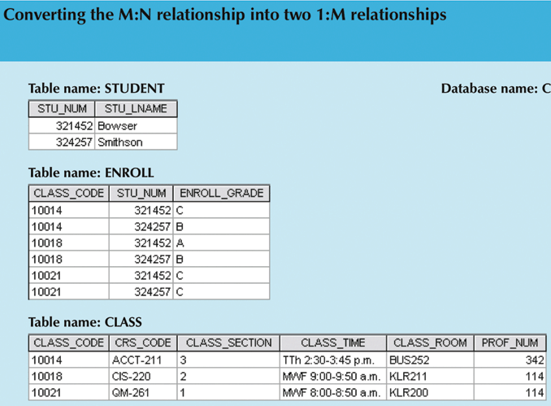

Slide 15
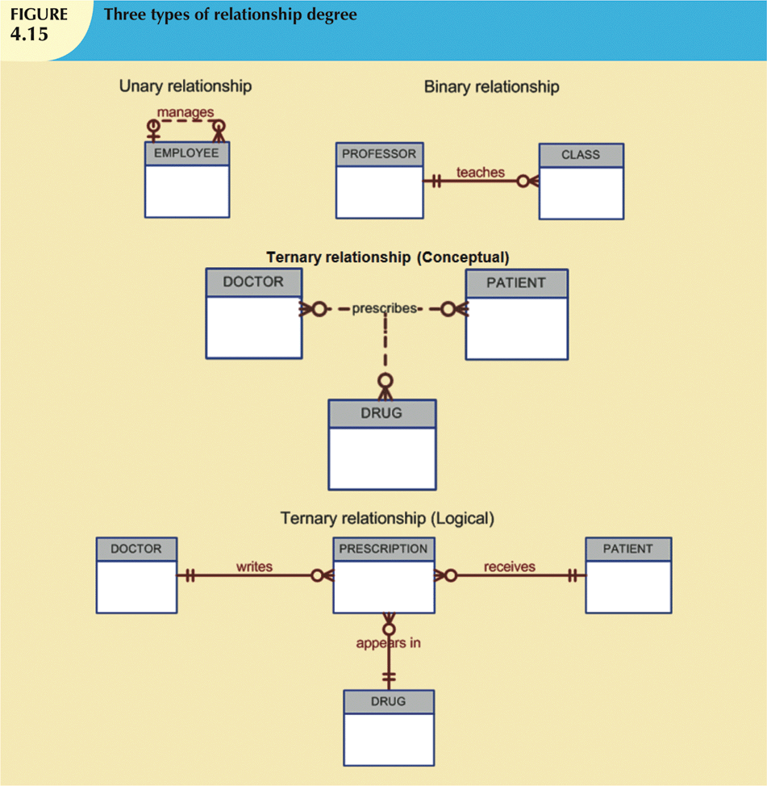
Relationship degree

Slide 16
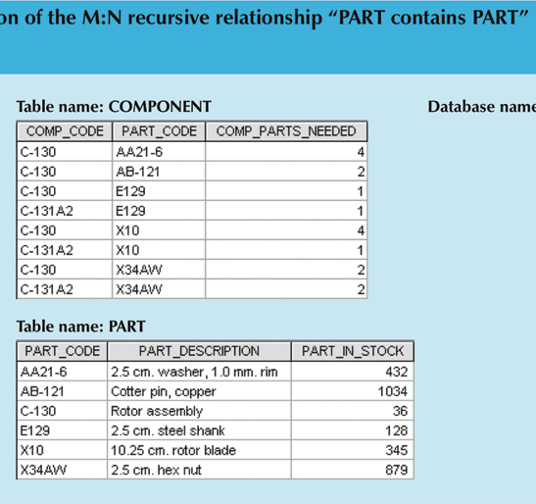
Unary/Recursive Relationships
is a component of
PART

Slide 17
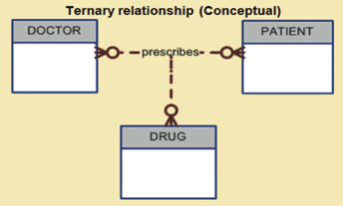
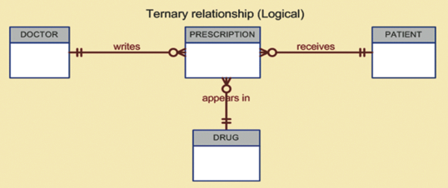
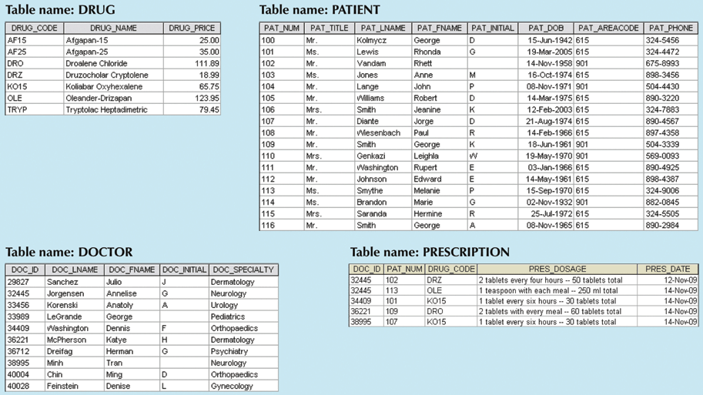

Slide 18
Existence dependence (for entities)
Existence dependence
Entity exists in database only when it is associated with another related entity occurrence
E.g. a Chapter is dependent on a Book; a Room is dependent on a Building
Participation is mandatory (minimum 1)
Existence independence
Entity can exist apart from one or more related entities
Sometimes such an entity is referred to as a strong or regular entity
E.g. a Book and an Illustrator; a Building and a Corporation
Participation is optional (minimum 0)

Slide 19
Relationship Strength
Weak (non-identifying) relationships
“Weak” because the entities could still exist even without the weak relationship (dashed line in ERD)
Exists if PK of related entity (many side) does not contain FK copied from parent entity (one side)
Strong (identifying) relationships
“Strong” because one of the entities (the entity on the many side) could not exist without the strong relationship (solid line in ERD)
“Identifying” because the identity (PK) of the entity on the many side depends on the other entity
Exists when PK of related entity (many side) contains FK copied from parent entity (one side)
Simple rule for correctly drawing ERDs:
By default, all relationships are weak (dashed line)
Exception: if an entity’s PK contains an FK, then the relationship that contributed that FK is strong (solid line)

Slide 20
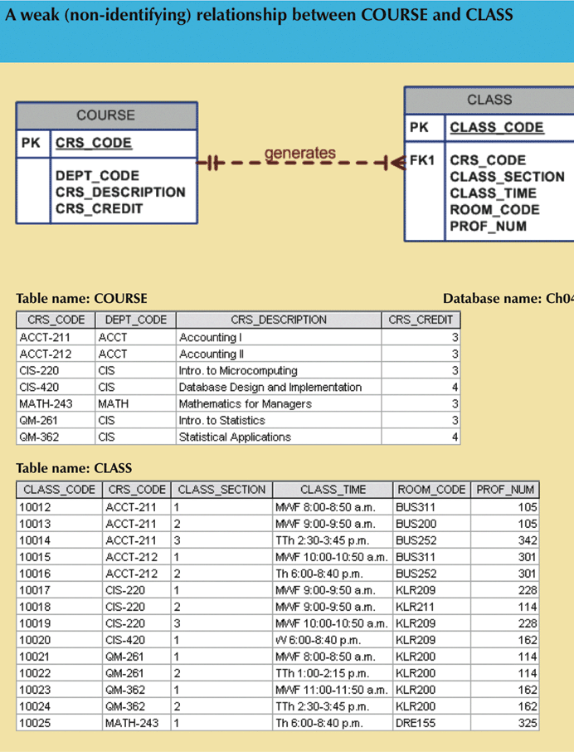
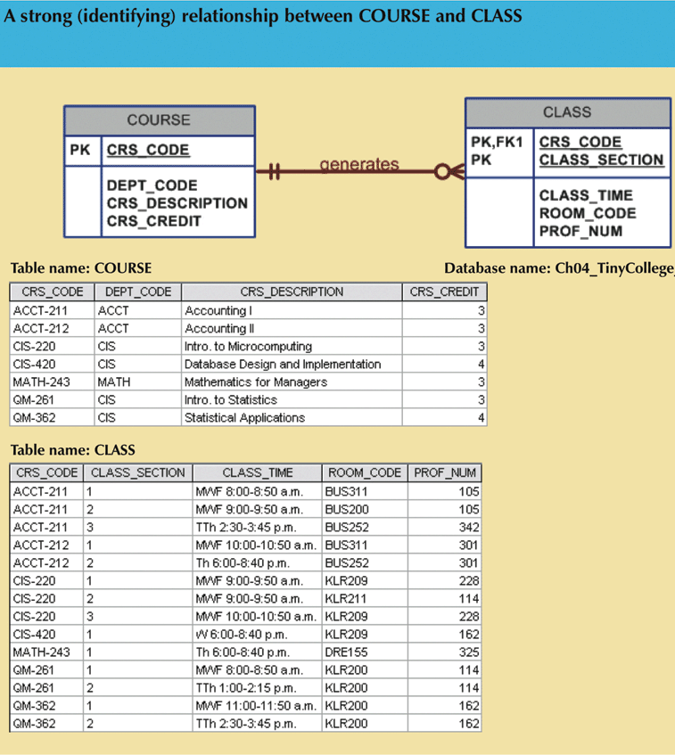

Slide 21
Weak Entities
Weak entity meets two conditions
Existence-dependent
Primary key partially or totally derived from parent entity in relationship
Strong entity + weak entity = strong relationship
a weak entity cannot exist without a strong relationship to hold it
Strong entity + strong entity = weak relationship
Both entities could still exist even without the relationship

Slide 22
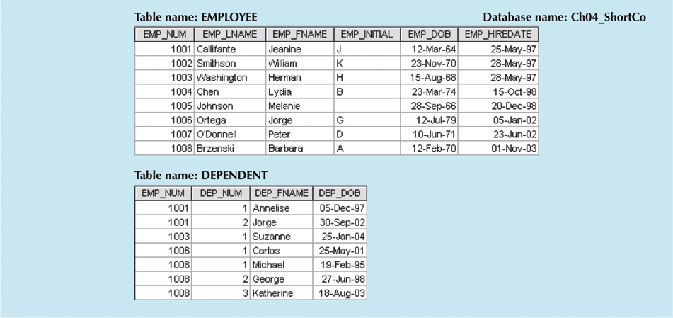
enrols

Slide 23
ERD design considerations

Slide 24
Database design challenges: Conflicting goals
Database designers must make design compromises
Conflicting goals: design standards, processing speed, information requirements
Important to meet logical requirements and design conventions
Design is of little value unless it delivers all specified query and reporting requirements
Some design and implementation problems do not yield “clean” solutions

Slide 25
Derived attribute
Value may be calculated from other attributes
E.g. age, GPA, account balance, number of visits
Need not be physically stored within database
Decision rule: Use a stored calculation (instead of a derived attribute) if:
Attribute’s value is constant (rarely changes)
Attribute is used frequently

Slide 26
Summary of Chapter 4: ER Modeling
Attributes could be simple or composite; they can be single-valued or multi-valued
Relationships have various important properties: connectivity, degree and strength
Entities in relationships have various important properties: cardinality, participation and existence-dependence
ERD design is both art and science; it often needs to reconcile conflicting goals

Slide 27
Sources
Most of the slides are adapted from Database Systems: Design, Implementation and Management by Carlos Coronel and Steven Morris. 11th edition (2015) published by Cengage Learning. ISBN 13: 978-1-285-19614-5
Other sources are noted on the slides themselves

